Slide 1
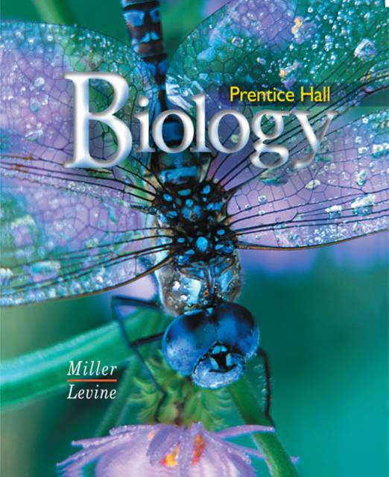
Biology

Slide 2
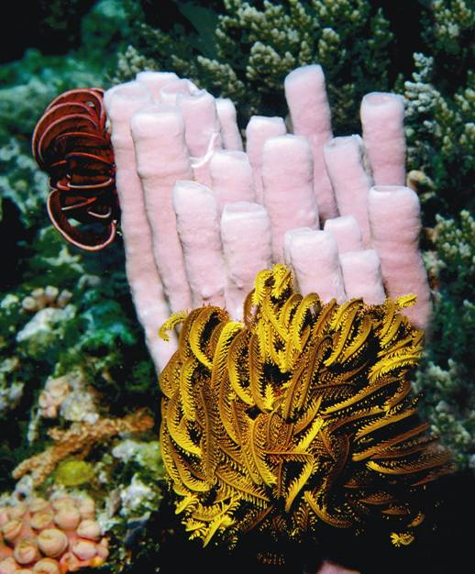
26-2 Sponges
Notes:
Photo Credit: Fred McConnaughey/Photo Researchers, Inc.

Slide 3
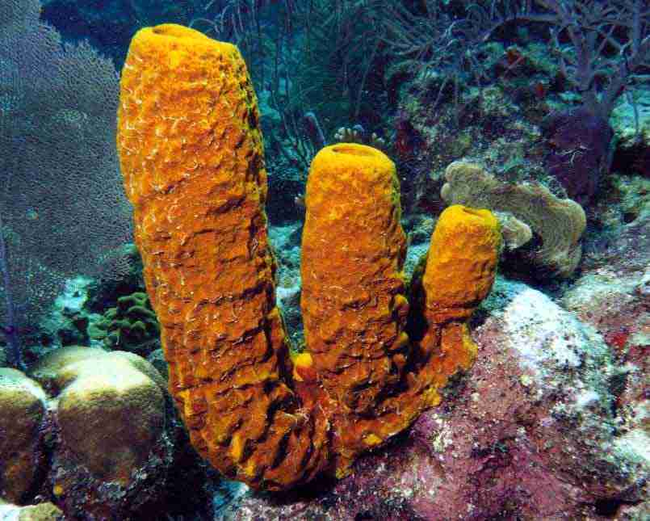
What is a Sponge?
What is a Sponge?
Sponges are in the phylum Porifera which means “pore-bearers.”
Sponges live their entire adult life attached to a single spot.

Slide 4
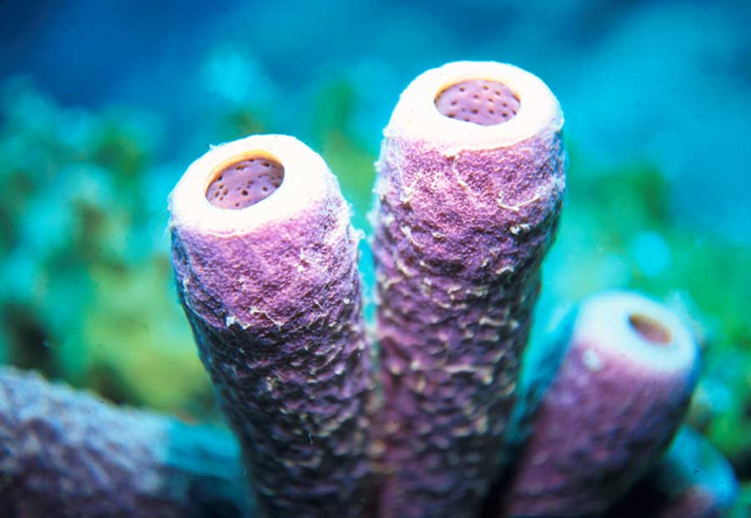
What is a Sponge?
Sponges are classified as animals because they are :
multicellular
heterotrophic
have no cell walls
contain a few specialized cells

Slide 5
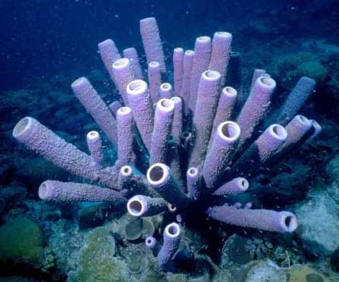
Form and Function in Sponges
Form and Function in Sponges
Sponges do not have a mouth or gut, and they have no tissues or organ systems.

Slide 6
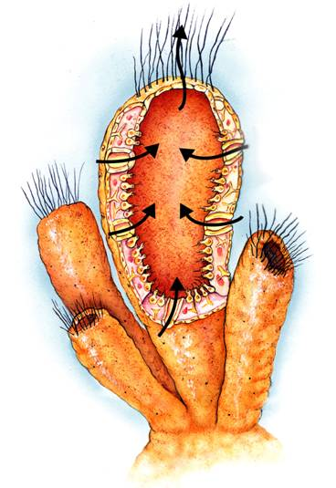
Form and Function in Sponges
Body Plan
Sponges are asymmetrical; they have no front or back ends, no left or right sides.
Notes:
Sponges carry out basic functions, such as feeding and circulation, by moving water through their bodies.

Slide 7
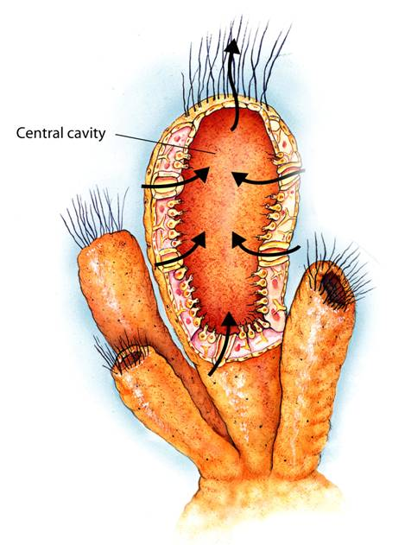
Form and Function in Sponges
The body of a sponge forms a wall around a large central cavity through which water is circulated continually.
Central cavity
Notes:
Sponges carry out basic functions, such as feeding and circulation, by moving water through their bodies.

Slide 8
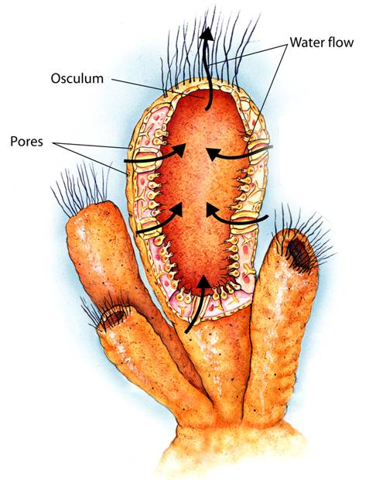
Form and Function in Sponges
Water flow
Water enters through pores located in the body wall and leaves through the osculum, a large hole at the top of the sponge.
Osculum
Pores
Notes:
Sponges carry out basic functions, such as feeding and circulation, by moving water through their bodies.

Slide 9
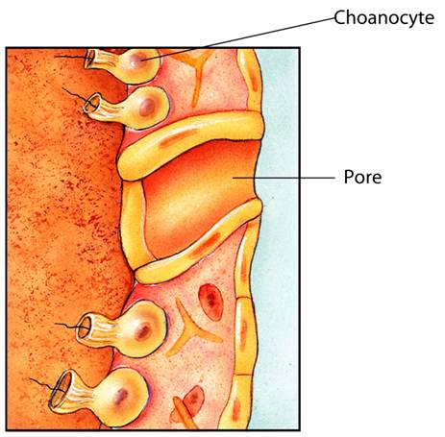
Form and Function in Sponges
Choanocyte
Choanocytes are specialized cells that use flagella to move a steady current of water through the sponge.
Pore
Notes:
Sponges carry out basic functions, such as feeding and circulation, by moving water through their bodies. Choanocytes use flagella to move water through pores in the wall of the sponge and out through the osculum. As water moves through the sponge, food particles are filtered from the water, and wastes are removed from the sponge.

Slide 10
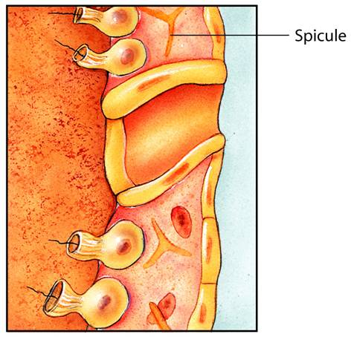
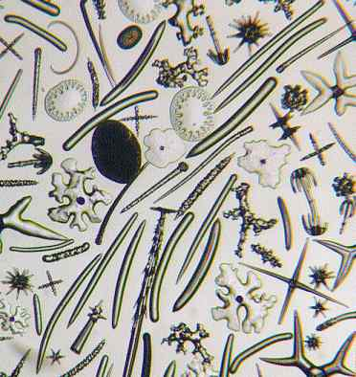
Form and Function in Sponges
A spicule is a spike-shaped structure made of calcium carbonate or silica.
Spicule
Spicules are made by archaeocytes, which are specialized cells that move around within the walls of the sponge.
Notes:
Sponges carry out basic functions, such as feeding and circulation, by moving water through their bodies.

Slide 11
Form and Function in Sponges
Feeding
Sponges are filter feeders.
As water moves through the sponge, food particles are trapped and engulfed by choanocytes that line the body cavity.

Slide 12
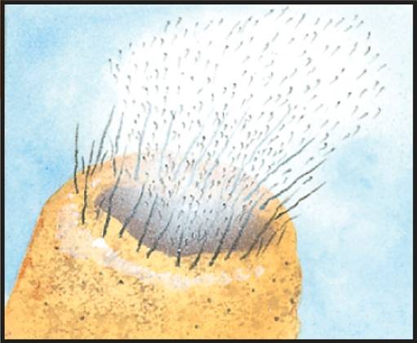
Form and Function in Sponges
Reproduction
Sponges can reproduce sexually or asexually.
The eggs are fertilized inside the sponge’s body, in a process called internal fertilization.

Slide 13
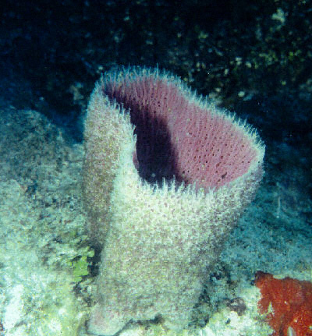
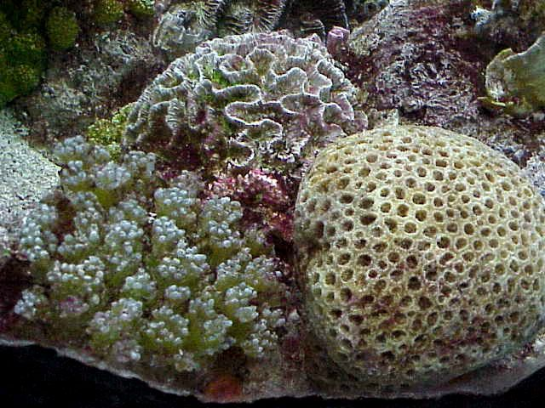
Ecology of Sponges
Ecology of Sponges
Sponges are important in aquatic ecology.
They provide habitats for marine animals such as snails, sea stars, and shrimp.

Slide 14
26-2

Slide 15
26-2
In sponges, a spike-shaped structure made of chalklike calcium carbonate or glasslike silica is a(an)
spicule.
archaeocyte.
choanocyte.
epidermal cell.

Slide 16
26-2
An immature stage of an organism that looks different from the adult form is a(an)
gemmule.
larva.
archaeocyte.
choanocyte.

Slide 17
26-2
Specialized cells that use flagella to move water through the sponge are
gemmules.
pores.
spicules.
choanocytes.

Slide 18
26-2
Sponges are
detritivores.
carnivores.
filter feeders.
herbivores.

Slide 19
26-2
Sponges can reproduce
sexually only.
asexually only.
both sexually and asexually.
by metamorphosis.

Slide 20
END OF SECTION

